Slide 1

Futurense Technologies
Project Report
Group :- F Names:
1.ASWATHI SUJITH
2.SURUVU SREE VARDHAN
3.S.JAYA SATYENDRA SAI
4.D.DHARANIDHARA REDDY

Slide 2
Index
S.NO | PHASE | PG.NO
1 | PHASE-1 | 3-17
2 | PHASE-2 | 18-26
3 | PHASE-3 | 27-38
4 | PHASE-4 | 39-47
5 | PHASE-5 | 48-66
6 | CONCLUSION | 67-68
7 | REFERENCES | 69

Slide 3
Problem Statement-1
How is the distribution of Purchase amounts across different product categories? What is the average purchase amount for each product category? Visualize the same using plots. Which product category has the highest and the lowest purchase amounts?
DESCRIPTION
we need to analyze the distribution of purchase amounts across different product categories, calculate the average purchase amount for each category, and visualize these findings using plots.
This approach, you can effectively analyze and visualize the distribution of purchase amounts across different product categories, providing valuable insights for business decisions.

Slide 4
Code
# Import Libraries
import pandas as pd
import seaborn as sns
import matplotlib.pyplot as plt
import numpy as np
from scipy.stats import pearsonr
sales_df = pd.read_csv('sales Data.csv')
# Initial data cleaning: fixing negative and extremely high values
sales_df['PurchaseAmount'] = sales_df['PurchaseAmount'].clip(lower=0, upper=Sales_Dataset['PurchaseAmount'].quantile(0.99))
# Boxplot for distribution of purchase amounts
plt.figure(figsize=(10, 6))
sns.barplot(x='ProductCategory', y='PurchaseAmount', data=sales_df)
plt.title('Purchase Amount Distribution by Product Category')
plt.show()
# Average purchase amount per product category
avg_purchase_per_category = sales_df.groupby('ProductCategory')['PurchaseAmount'].mean()
print("Average Purchase Amount per Product Category:\n", avg_purchase_per_category)

Slide 5
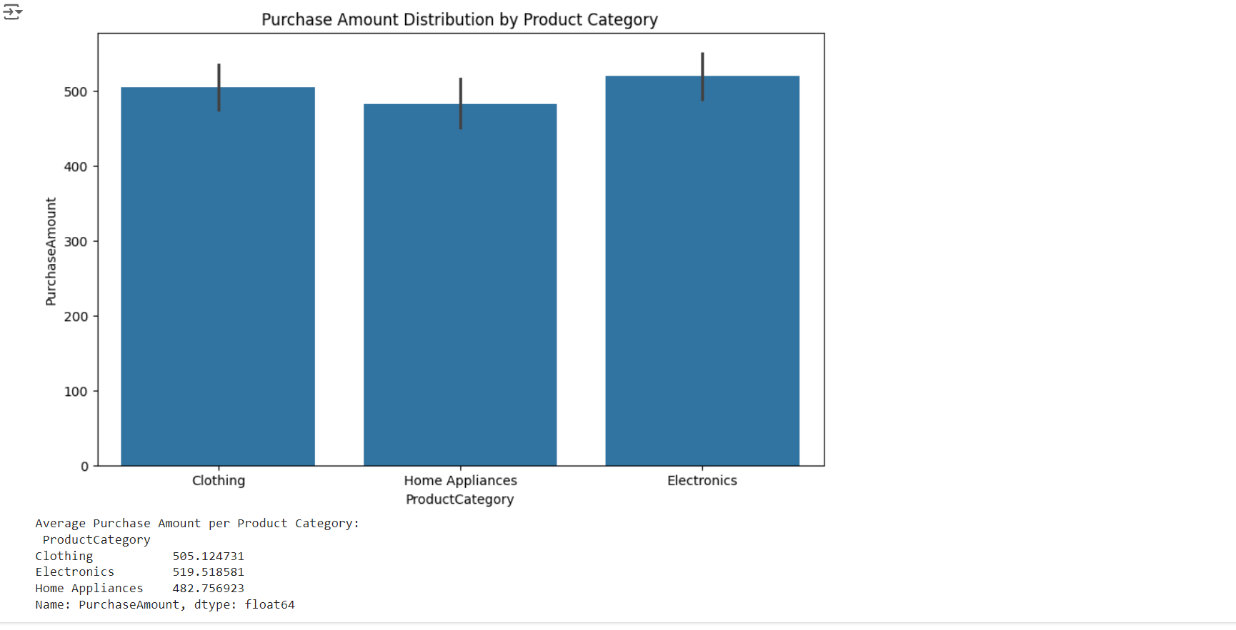
Results(Screenshot)

Slide 6
Problem Statement-2 How do ratings vary based on customer segments? What is the average rating for each customer segment? Which customer segment has the highest and lowest ratings? Create a bar plot to compare the average ratings across customer segments.
DESCRIPTION
Need to analyze how ratings vary based on customer segments, calculate the average rating for each customer segment, and visualize these findings using a bar plot.
This approach, you can effectively analyze and visualize how ratings vary based on customer segments, providing valuable insights into customer satisfaction and areas for improvement.

Slide 7
Code
# Problem Statement 2: Average ratings based on customer segments
avg_rating_per_segment = sales_df.groupby('CustomerSegment')['Rating'].mean().reset_index()
sns.barplot(data=avg_rating_per_segment, x='CustomerSegment', y='Rating')
plt.title('Average Rating by Customer Segment')
plt.xlabel('Customer Segment')
plt.ylabel('Average Rating')
plt.show()
print("Average Rating per Customer Segment:\n", avg_rating_per_segment)

Slide 8
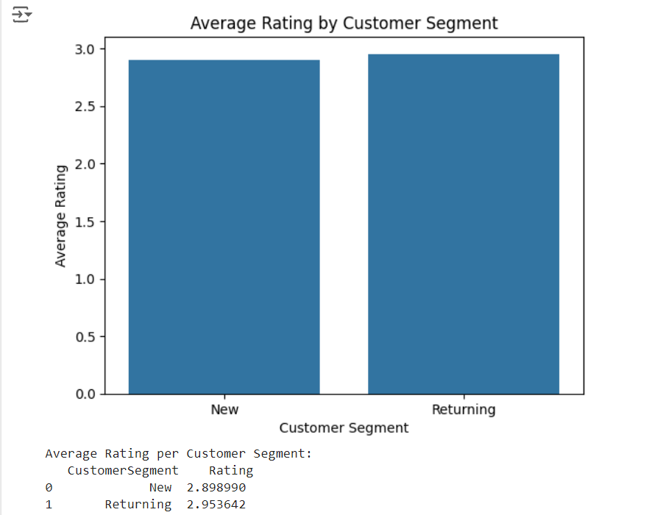
Results(Screenshot)

Slide 9
Problem statement -3 Is there any correlation between age and purchase amount? Visualize the same using a heatmap correlation matrix and a scatter plot. Is the correlation between age and purchase amount statistically significant?
DESCRIPTION
Need to determine if there is a correlation between age and purchase amount. We'll visualize this correlation using a heatmap correlation matrix and a scatter plot, and then determine if the correlation is statistically significant.
This approach, you can effectively analyze and visualize the correlation between age and purchase amount, providing valuable insights into how these two variables are related.

Slide 10
Code
# Problem Statement 3: Correlation between age and purchase amount
# Removing rows with missing values in Age or PurchaseAmount
correlation = sales_df.dropna(subset=['Age', 'PurchaseAmount'])
print("Correlation matrix:\n", correlation)
# Heatmap correlation matrix
correlation_matrix = correlation[['Age', 'PurchaseAmount']].corr()
sns.heatmap(correlation_matrix, annot=True, cmap='coolwarm')
plt.title('Correlation Matrix')
plt.show()
# Scatter plot
sns.scatterplot(correlation, x='Age', y='PurchaseAmount')
plt.title('Scatter Plot of Age vs Purchase Amount')
plt.xlabel('Age')
plt.ylabel('Purchase Amount')
plt.show()
# Statistical significance
correlation, p_value = pearsonr(correlation['Age'], correlation['PurchaseAmount'])
print(f"Correlation: {correlation}, P-value: {p_value}")

Slide 11
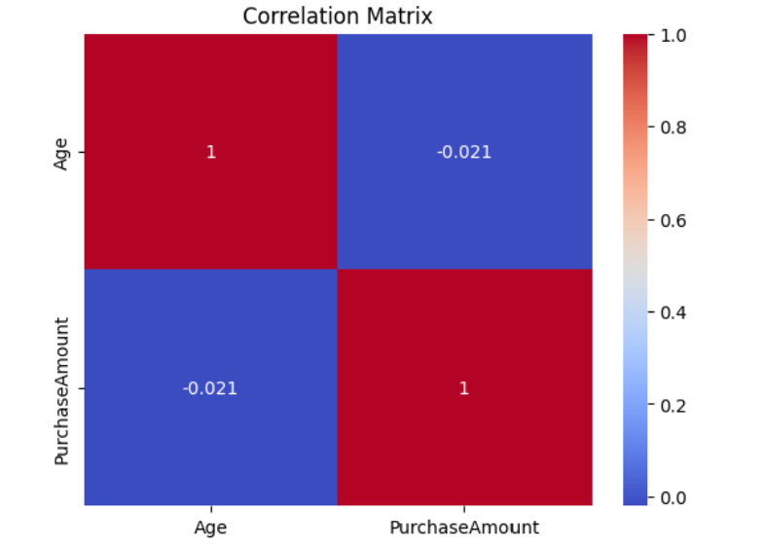
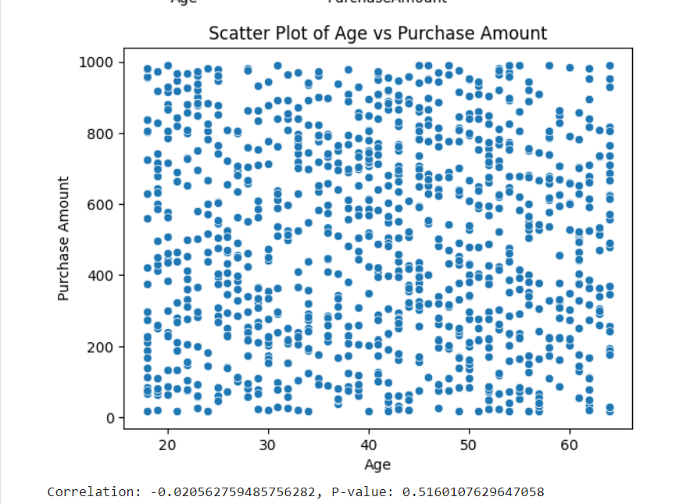
Results(Screenshot)

Slide 12
Problem statement-4 How many unique customers made purchases in each region? How many unique customers are there in total? Which region has the highest and lowest numbers of unique customers? Create any plot visualization to visualize the number of unique customers in each region.
DESCRIPTION
Need to determine the number of unique customers who made purchases in each region, the total number of unique customers, and identify the regions with the highest and lowest numbers of unique customers.
This approach, you can effectively analyze and visualize the number of unique customers in each region, providing valuable insights into regional customer distribution and potential areas for growth.

Slide 13
Code
# Problem Statement 4: Unique customers per region
unique_customers_by_region = Sales_Dataset.groupby('Region')['CustomerID'].nunique().reset_index()
unique_customers_total = Sales_Dataset['CustomerID'].nunique()
sns.barplot(data=unique_customers_by_region, x='Region', y='CustomerID')
plt.title('Number of Unique Customers by Region')
plt.xlabel('Region')
plt.ylabel('Number of Unique Customers')
plt.show()
# Statistical significance
print(f"Unique customers by region:\n{unique_customers_by_region}")
print(f"Total unique customers: {unique_customers_total}")

Slide 14
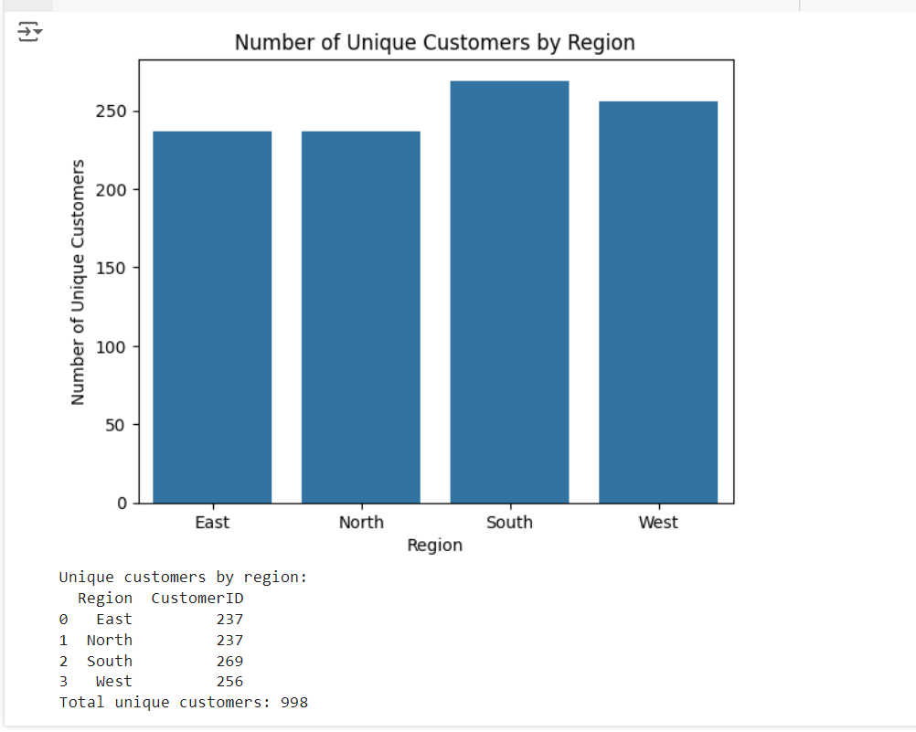
Results(Screenshot)

Slide 15
Problem statement-5 Calculate the total purchase amount for each payment method. What are the different payment methods available? What is the total purchase amount for each payment method? Create a pie chart to show the distribution of total purchase amounts across payment methods.
DESCRIPTION
Identify unique payment methods in the dataset.Calculate the total purchase amount for each payment method.
Visualize the distribution of total purchase amounts across payment methods using a pie chart.

Slide 16
Code
# Problem Statement 5: Total purchase amount by payment method
total_purchase_by_payment_method = Sales_Dataset.groupby('PaymentMethod')['PurchaseAmount'].sum().reset_index()
payment_methods = total_purchase_by_payment_method['PaymentMethod'].unique()
plt.pie(total_purchase_by_payment_method['PurchaseAmount'], labels=payment_methods, autopct='%1.1f%%')
plt.title('Total Purchase Amount by Payment Method')
plt.show()
print(f"Total purchase amount by payment method:\n{total_purchase_by_payment_method}")

Slide 17
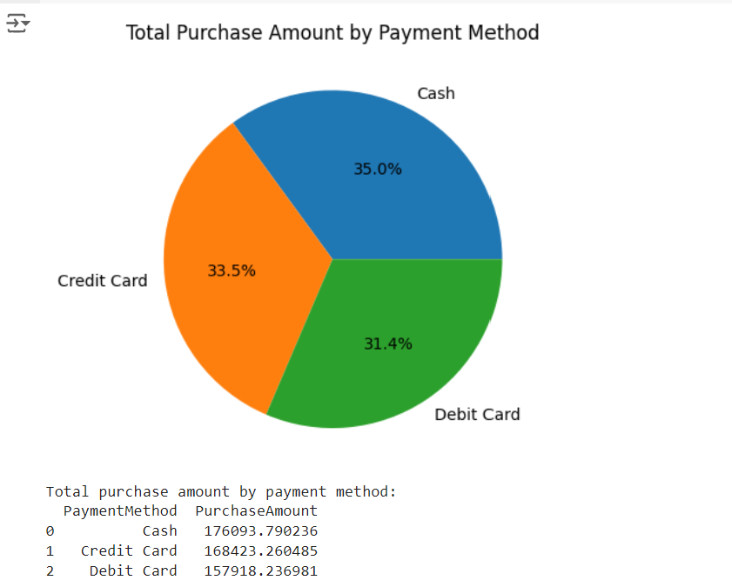
Results(Screenshot)

Slide 18
Problem statement-6 Design a scalable data ingestion pipeline. Document the strategy, including data sources, formats, and frequency.
DESCRIPTION
Define the sources from which data will be ingested (e.g., CSV files, databases, APIs).Specify the data formats (e.g., CSV, JSON, Parquet) and frequency of ingestion (e.g., daily, hourly).
Document the pipeline architecture, including any ETL processes and tools used for automation.

Slide 19
Code
# problem statement 6
!pip install pandas sqlalchemy
import pandas as pd
from sqlalchemy import create_engine
# Step 1: Data Extraction
def extract_data(file_path):
# Load CSV file into a DataFrame
df = pd.read_csv('sales Data.csv')
return df
# Step 2: Data Transformation
def transform_data(df):
# Example transformations: Handle missing values, convert data types, etc.
df = df.dropna() # Drop rows with missing values
df['PurchaseDate'] = pd.to_datetime(df['PurchaseDate']) # Convert date column
return df
# Step 3: Data Loading
def load_data(df, db_engine):
# Load data into SQL database
df.to_sql('salesdata', db_engine, if_exists='replace', index=False)

Slide 20
def main():
# File path
file_path = '/mnt/data/Sales Dataset.csv'
# Database connection string (using SQLite for simplicity)
db_engine = create_engine('sqlite:///sales.db')
# Run the pipeline
df = extract_data(file_path)
df = transform_data(df)
load_data(df, db_engine)
# Verify the data was loaded
result = pd.read_sql('SELECT * FROM salesdata LIMIT 5', db_engine)
print(result) # Indent this line to be included in the main function
if __name__ == '__main__':
main()

Slide 21
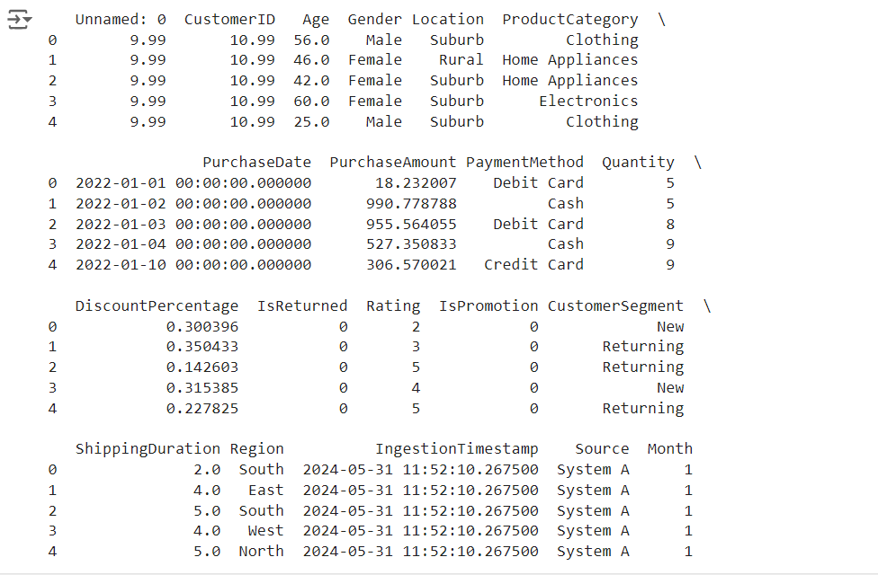
Results(Screenshot)

Slide 22
Problem statement-7 Implement the data ingestion pipeline using Python and Pandas, connecting it to a SQL database for data storage.
DESCRIPTION
Define the sources from which data will be ingested (e.g., CSV files, databases, APIs).Specify the data formats (e.g., CSV, JSON, Parquet) and frequency of ingestion (e.g., daily, hourly).
Document the pipeline architecture, including any ETL processes and tools used for automation.

Slide 23
Code
# problem statement 7
from sqlalchemy import create_engine
# Example SQL ingestion
# Adjust the connection string as needed
engine = create_engine('sqlite:///sales.db') # Using SQLite for simplicity
sales_df.to_sql('salesdata', engine, if_exists='replace', index=False)
# Verify the data was written
query_result = pd.read_sql('SELECT * FROM salesdata LIMIT 5', engine)
print(query_result)

Slide 24
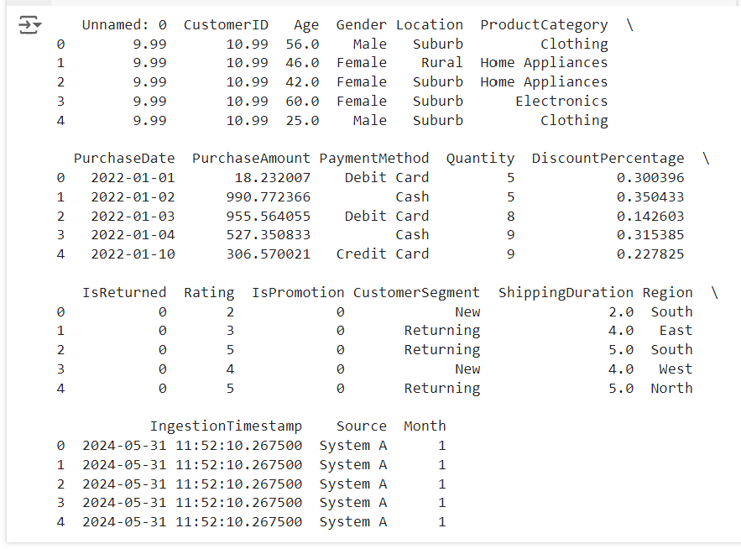
Results(Screenshot)

Slide 25
Problem statement-8 Optimize the ingestion pipeline for performance and storage efficiency. Document the optimization techniques used.
DESCRIPTION
Identify bottlenecks in the ingestion pipeline and optimize code for faster execution.Implement techniques such as chunking, parallel processing, and compression to improve performance.
Optimize data storage strategies to reduce storage space and enhance efficiency.

Slide 26
Code
# problem statement 8
# Example of chunking CSV ingestion
chunk_size = 10000
chunks = pd.read_csv('sales Data.csv', chunksize=chunk_size)
for chunk in chunks:
chunk.to_sql('salesdata', engine, if_exists='append', index=False)
# Document optimization techniques:
# 1. Use chunking for large CSV files to avoid memory overload.
# 2. Use multiprocessing to parallelize API calls.
# 3. Optimize SQL queries to fetch only necessary columns and rows.
# 4. Compress data before storing in the data lake.
# 5. Use efficient data formats like Parquet for storage.
# 6. Implement indexing in the SQL database for faster queries.

Slide 27
Problem statement-9 Calculate the average shipping duration for each location. What are the different locations available in the dataset? Create a bar plot to compare average shipping durations.
DESCRIPTION
Calculate the average shipping duration for each unique location in the dataset.Identify the different locations available.
Visualize the average shipping durations using a bar plot for comparison.

Slide 28
Code
# problem statement 9
# Average shipping duration per location
avg_shipping_duration_per_location = sales_df.groupby('Location')['ShippingDuration'].mean()
plt.figure(figsize=(10, 6))
avg_shipping_duration_per_location.plot(kind='bar')
plt.title('Average Shipping Duration by Location')
plt.ylabel('Average Shipping Duration (days)')
plt.show()
print("Average Shipping Duration per Location:\n", avg_shipping_duration_per_location)

Slide 29
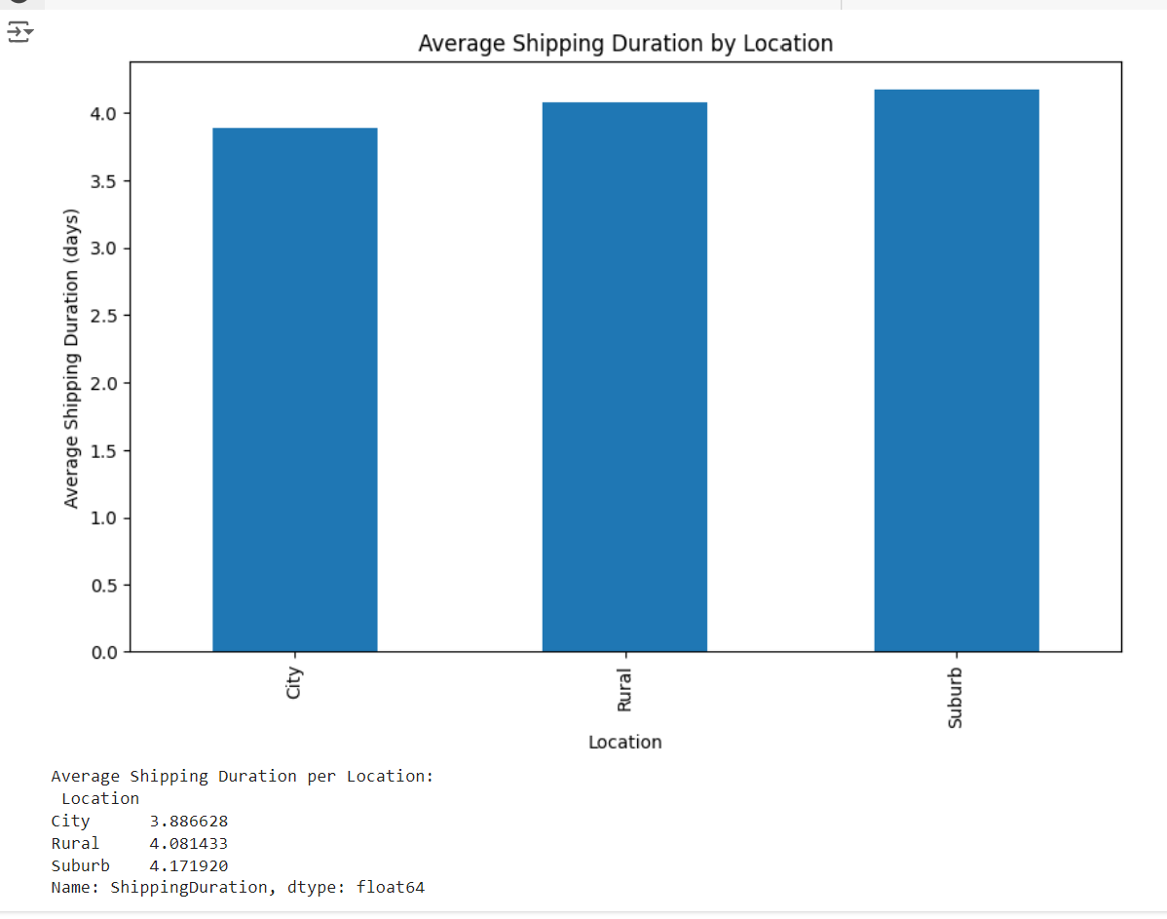
Results(Screenshot)

Slide 30
Problem statement-10 What is the return rate for each product category? Calculate the percentage of purchases returned and visualize the findings.
DESCRIPTION
Compute the return rate (percentage of purchases returned) for each product category.
Visualize the return rates to identify categories with higher return rates.

Slide 31
Code
# problem statement 10
# Return rate per product category
return_rate_per_category = sales_df.groupby('ProductCategory')['IsReturned'].mean() * 100
plt.figure(figsize=(10, 6))
return_rate_per_category.plot(kind='bar')
plt.title('Return Rate by Product Category')
plt.ylabel('Return Rate (%)')
plt.show()
print("Return Rate per Product Category:\n", return_rate_per_category)

Slide 32
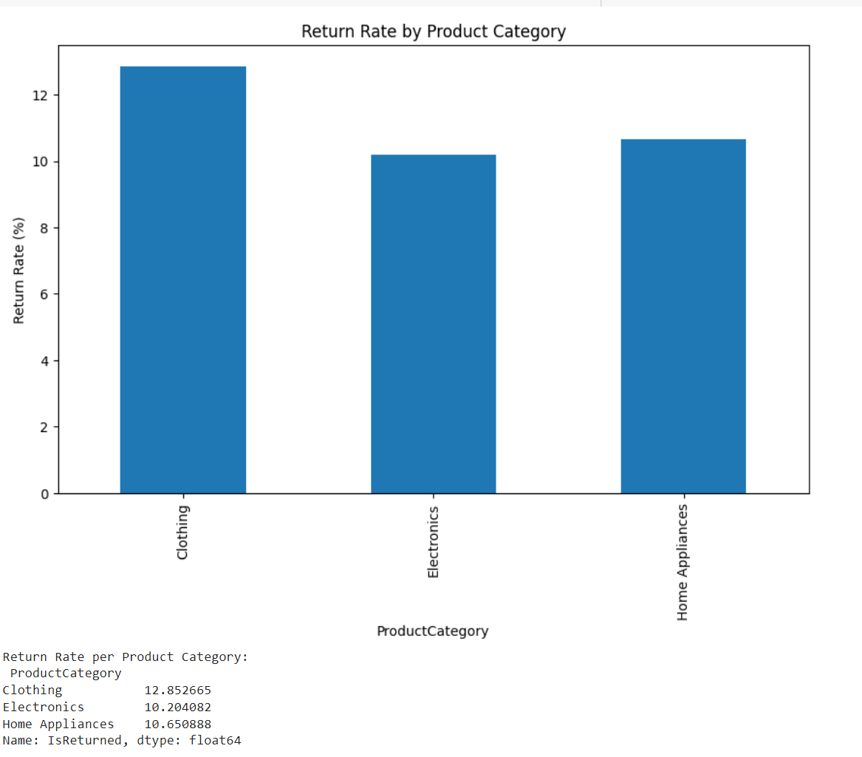
Results(Screenshot)

Slide 33
Problem statement-11 Analyze purchase amounts for male and female customers. Perform a statistical test to determine if there's a significant difference between the two groups.
DESCRIPTION
Calculate the purchase amounts for male and female customers separately.
Perform a statistical test (e.g., t-test) to compare the purchase amounts between the two groups.
Determine if there is a significant difference in purchase amounts based on gender.

Slide 34
Code
# problem statement 11
from scipy.stats import ttest_ind
# Barplot for purchase amounts by gender
plt.figure(figsize=(10, 6))
sns.barplot(x='Gender', y='PurchaseAmount', data=sales_df)
plt.title('Purchase Amounts by Gender')
plt.show()
# Statistical test (t-test)
male_purchase = sales_df[sales_df['Gender'] == 'Male']['PurchaseAmount']
female_purchase = sales_df[sales_df['Gender'] == 'Female']['PurchaseAmount']
t_stat, p_value = ttest_ind(male_purchase, female_purchase)
print(f"T-statistic: {t_stat}, P-value: {p_value}")

Slide 35
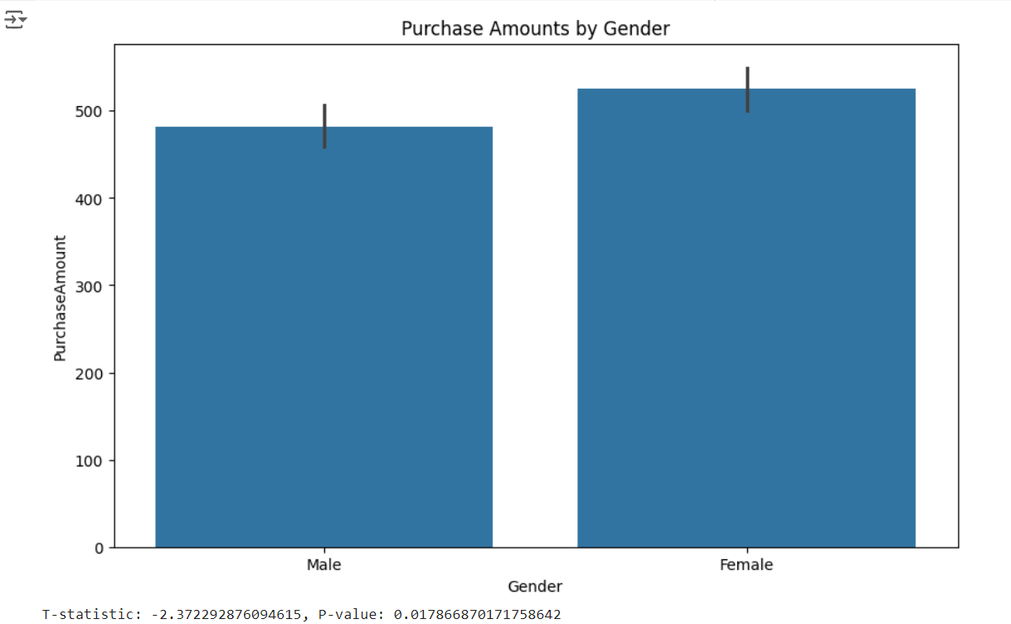
Results(Screenshot)

Slide 36
Problem statement-12 Analyze how purchase amounts vary based on the day of the week. Create a plot to visualize the trends and compare weekends versus weekdays.
DESCRIPTION
Calculate purchase amounts for each day of the week.Visualize the trends using a plot (e.g., line plot or bar plot).
Compare purchase amounts between weekends (Saturday and Sunday) and weekdays (Monday to Friday).

Slide 37
Code
# problem statement 12
# Assuming there's a 'PurchaseDate' column in the dataset
sales_df['PurchaseDate'] = pd.to_datetime(sales_df['PurchaseDate'], format='%Y-%m-%d') # Changed the date format to match the data
sales_df['Day_of_Week'] = sales_df['PurchaseDate'].dt.day_name()
# Barplot for purchase amounts by day of the week
plt.figure(figsize=(10, 6))
sns.barplot(x='Day_of_Week', y='PurchaseAmount', data=sales_df)
plt.title('Purchase Amounts by Day of the Week')
plt.show()
# Compare weekends vs weekdays
sales_df['IsWeekend'] = sales_df['Day_of_Week'].isin(['Saturday', 'Sunday'])
avg_purchase_weekend = sales_df.groupby('IsWeekend')['PurchaseAmount'].mean()
print("Average Purchase Amount (Weekends vs Weekdays):\n", avg_purchase_weekend)

Slide 38
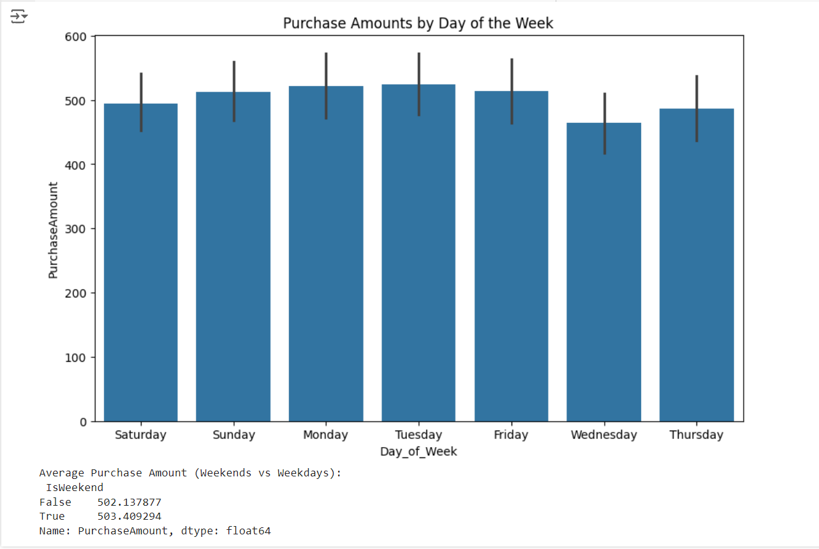
Results(Screenshot)

Slide 39
Problem statement-13 Design the data warehouse schema. Document the strategy, including tables, relationships, and indexing.
DESCRIPTION
Design the structure of the data warehouse schema including tables for different entities, relationships between tables, and indexing strategy.
Document the schema design with clear explanations of table attributes, primary keys, foreign keys, and any indexing applied.

Slide 40
Code
#Problem Statement 13
import pandas as pd
import matplotlib.pyplot as plt
# Total purchase amount per product category
total_purchase_per_category = sales_df.groupby('ProductCategory') ['PurchaseAmount'].sum()
plt.figure(figsize=(10,6))
total_purchase_per_category.plot(kind='bar', color='blue')
plt.title('Total Purchase Amount by Product Category')
plt.xlabel('Product Category')
plt.ylabel('Total Purchase Amount')
plt.xticks (rotation=45)
plt.show()
print("Total Purchase Amount per Product Category:\n", total_purchase_per_category)

Slide 41
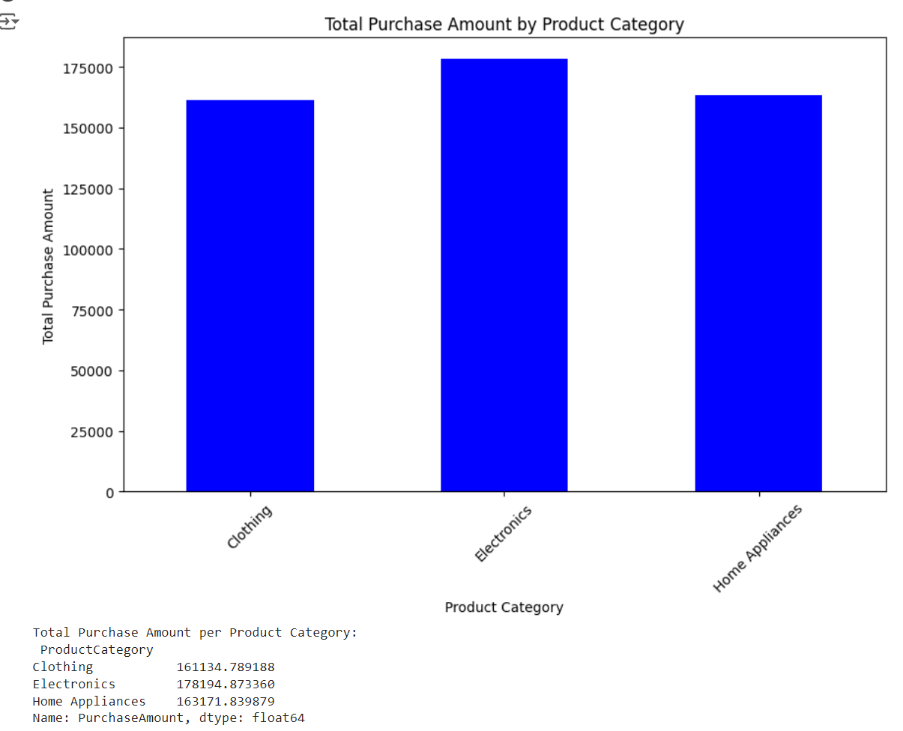
Results(Screenshot)

Slide 42
Problem statement-14 Implement the data warehouse using SQL. Optionally, use a cloud-based solution like Amazon RDS for better persistence.
DESCRIPTION
Implement the data warehouse schema in a SQL database management system.
Optionally, deploy the data warehouse on a cloud-based solution like Amazon RDS for better scalability and persistence.

Slide 43
Code
#Problem Statement 14
# Implement the data warehouse using SQL (example using SQLite)
# Assuming transformed data is in 'transformed_sales_df'
transformed_sales_df = data # Placeholder for transformed data
engine = create_engine('sqlite:///data_warehouse.db')
transformed_sales_df.to_sql('salesfact', engine, if_exists='replace', index=False)
# Verify the data was written
query_result = pd.read_sql('SELECT * FROM salesfact LIMIT 5', engine)
print(query_result)

Slide 44
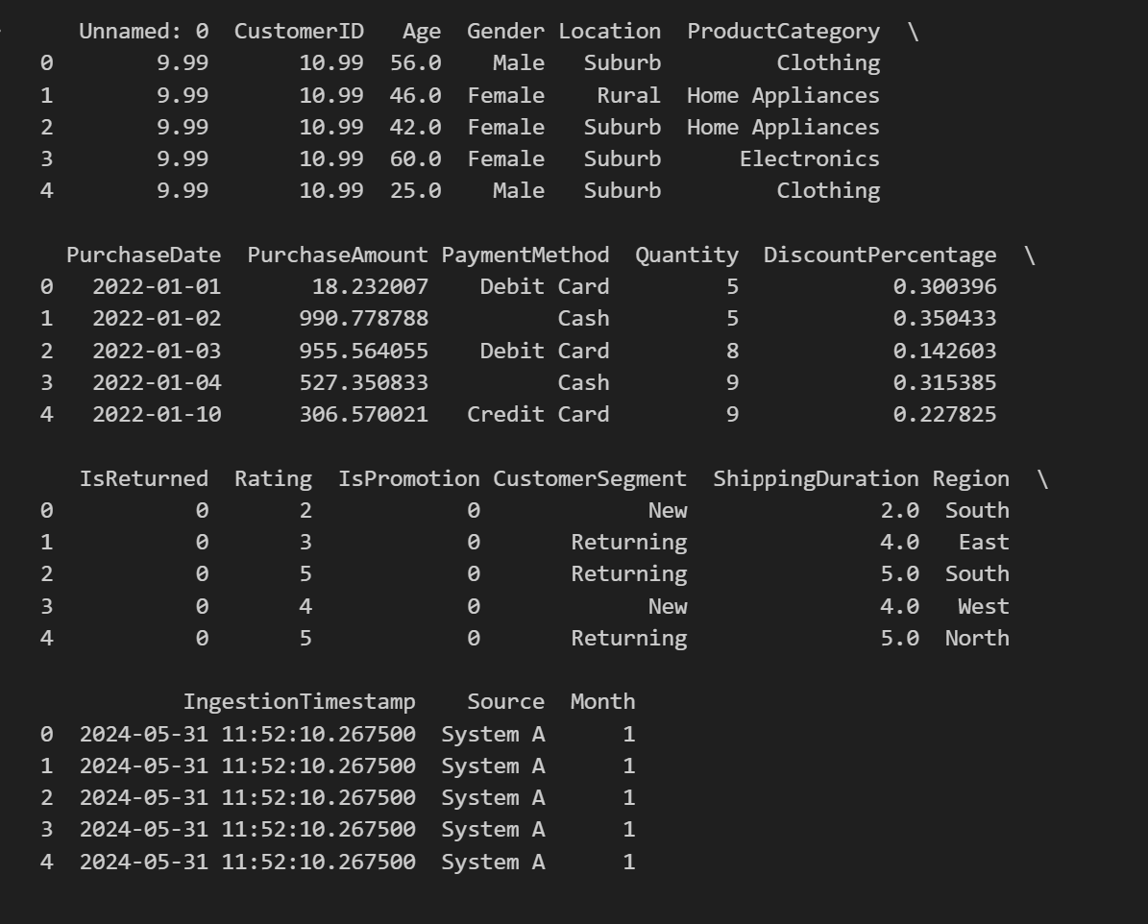
Results(Screenshot)

Slide 45
Problem statement-15 Load the transformed data into the data warehouse, ensuring data integrity and consistency.
DESCRIPTION
Develop an ETL (Extract, Transform, Load) process to transfer the transformed data into the data warehouse.
Ensure data integrity and consistency during the loading process by validating data against predefined rules and constraints.

Slide 46
Code
#Problem Statement 15
import pandas as pd
import matplotlib.pyplot as plt
#Total purchase amount per payment method
total_purchase_per_payment_method = sales_df.groupby('PaymentMethod') ['PurchaseAmount'].sum()
plt.figure(figsize=(8, 6))
total_purchase_per_payment_method.plot(kind='pie', autopct='%1.1f%%', startangle=90)
plt.title('Total Purchase Amount by Payment Method')
plt.ylabel('')
plt.show()
print("Total Purchase Amount per Payment Method:\n", total_purchase_per_payment_method)

Slide 47
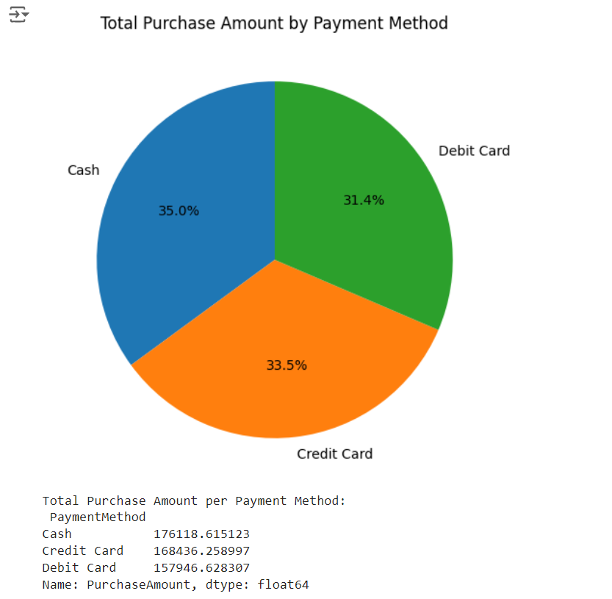
Results(Screenshot)

Slide 48
Problem statement-16 Analyze purchase amounts over time. Create a plot to show the trend of purchase amounts over the months and extract insights.
DESCRIPTION
Analyze the trend of purchase amounts over different months.
Create a line plot or bar plot to visualize the trend of purchase amounts over time.
Extract insights from the visualization, such as seasonal trends or changes in purchasing behavior

Slide 49
Code
#problem statement 16
import pandas as pd
import matplotlib.pyplot as plt
# Load the dataset
sales_data = pd.read_csv('sales Data.csv')
# Ensure the PurchaseDate column is correctly parsed as datetime
sales_data['PurchaseDate'] = pd.to_datetime(sales_data['PurchaseDate'], errors='coerce')
# Drop any rows where PurchaseDate could not be parsed
sales_data = sales_data.dropna(subset=['PurchaseDate'])
# Remove the highest purchase amount to address the outlier
sales_data = sales_data[sales_data['PurchaseAmount'] != sales_data['PurchaseAmount'].max()]
# Group by year and month, then sum the PurchaseAmount
sales_data['YearMonth'] = sales_data['PurchaseDate'].dt.to_period('M')
monthly_purchase_amounts = sales_data.groupby('YearMonth')['PurchaseAmount'].sum().reset_index()

Slide 50
# Ensure the YearMonth is sorted
monthly_purchase_amounts = monthly_purchase_amounts.sort_values('YearMonth')
# Convert YearMonth to string for better plotting
monthly_purchase_amounts['YearMonth'] = monthly_purchase_amounts['YearMonth'].astype(str)
# Plot the trend
plt.figure(figsize=(12, 6))
plt.plot(monthly_purchase_amounts['YearMonth'], monthly_purchase_amounts['PurchaseAmount'], marker='o')
plt.xlabel('Month-Year')
plt.ylabel('Total Purchase Amount')
plt.title('Trend of Purchase Amounts Over Time')
plt.xticks(rotation=45)
plt.grid(True)
plt.tight_layout() # Adjust the padding to prevent clipping
plt.show()

Slide 51
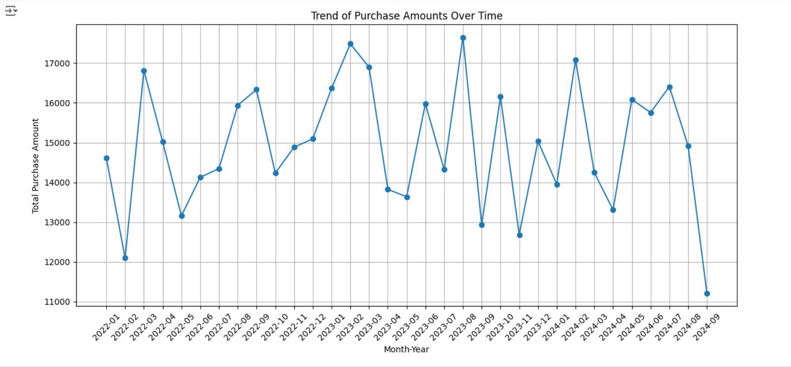
Results(Screenshot)

Slide 52
Problem statement-17 Investigate the relationship between purchase amount and discount percentage. Create a scatter plot and calculate the correlation.
DESCRIPTION
Analyze the correlation between purchase amount and discount percentage.
Create a scatter plot to visualize the relationship between the two variables.
Calculate the correlation coefficient to quantify the strength and direction of the relationship

Slide 53
Code
#problem statement 17
# Scatter plot and correlation between purchase amount and discount percentage
plt.figure(figsize=(10, 6))
sns.scatterplot(x='DiscountPercentage', y='PurchaseAmount', data=data)
plt.title('Purchase Amount vs. Discount Percentage')
plt.show()
correlation = data[['DiscountPercentage', 'PurchaseAmount']].corr()
print("Correlation between Discount Percentage and Purchase Amount:\n", correlation)

Slide 54
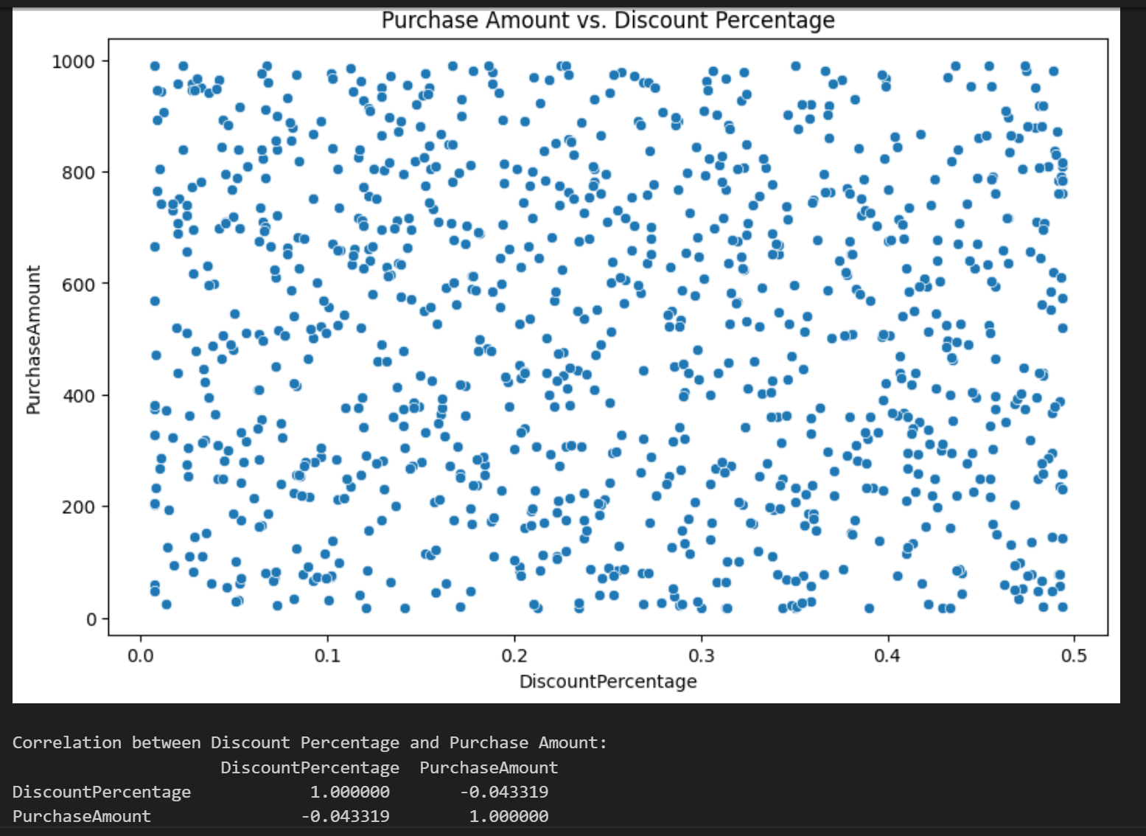
Results(Screenshot)

Slide 55
Problem statement-18 Identify instances of multiple purchases on the same day. Create a new column to flag these instances and visualize the findings.
DESCRIPTION
Identify instances where multiple purchases occur on the same day.
Create a new column in the dataset to flag these instances.
Visualize the findings to understand the frequency and distribution of multiple purchases on the same day.

Slide 56
Code
#problem statement18
import pandas as pd
import matplotlib.pyplot as plt
# Load the dataset
sales_data = pd.read_csv('sales Data.csv')
# Ensure the PurchaseDate column is correctly parsed as datetime
sales_data['PurchaseDate'] = pd.to_datetime(sales_data['PurchaseDate'], errors='coerce')
# Drop any rows where PurchaseDate could not be parsed
sales_data = sales_data.dropna(subset=['PurchaseDate'])
# Identify and flag multiple purchases on the same day
sales_data['PurchaseDay'] = sales_data['PurchaseDate'].dt.date
purchase_counts = sales_data.groupby(['CustomerID', 'PurchaseDay']).size().reset_index(name='PurchaseCount')

Slide 57
# Flag instances of multiple purchases
purchase_counts['MultiplePurchases'] = purchase_counts['PurchaseCount'] > 1
# Visualize the findings
multiple_purchase_counts = purchase_counts['MultiplePurchases'].value_counts()
plt.figure(figsize=(6, 4))
multiple_purchase_counts.plot(kind='bar', color=['blue', 'orange'])
plt.xlabel('Multiple Purchases')
plt.ylabel('Count')
plt.title('Count of Multiple Purchases on the Same Day')
plt.xticks(ticks=[0, 1], labels=['False', 'True'], rotation=0)
plt.grid(True)
plt.show()

Slide 58
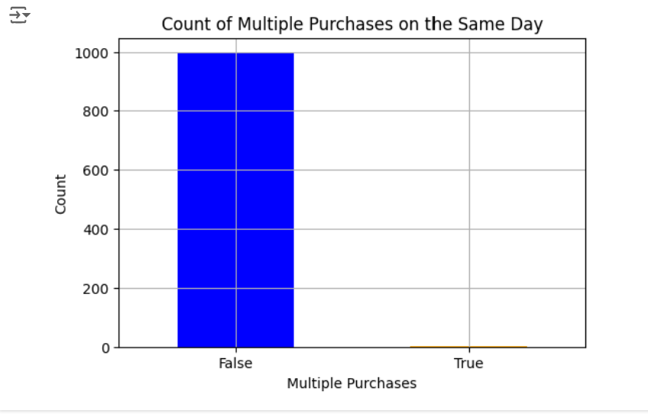
Results(Screenshot)

Slide 59
Problem statement-19 Calculate the total purchase amount for each customer segment and product category. Create a pivot table and visualize the results.
DESCRIPTION
Calculate the total purchase amount for each customer segment and product category.
Create a pivot table to summarize the total purchase amounts.
Visualize the results using appropriate charts or graphs to compare purchase amounts across different segments and categories

Slide 60
Code
#problem statement 19
import pandas as pd
import matplotlib.pyplot as plt
# Step 1: Load the sales data from the CSV file
sales_data = pd.read_csv('sales Data.csv')
# Step 2: Create a pivot table to calculate the total purchase amount for each customer segment and product category
pivot_table = pd.pivot_table(sales_data,
values='PurchaseAmount',
index='CustomerSegment',
columns='ProductCategory',
aggfunc='sum',
margins=True,
margins_name='Total')

Slide 61
# Step 3: Visualize the pivot table
plt.figure(figsize=(10, 6))
pivot_table.plot(kind='bar', stacked=True)
plt.title('Total Purchase Amount by Customer Segment and Product Category')
plt.xlabel('Customer Segment')
plt.ylabel('Total Purchase Amount')
plt.xticks(rotation=45)
plt.legend(title='Product Category')
plt.grid(axis='y')
plt.show()

Slide 62
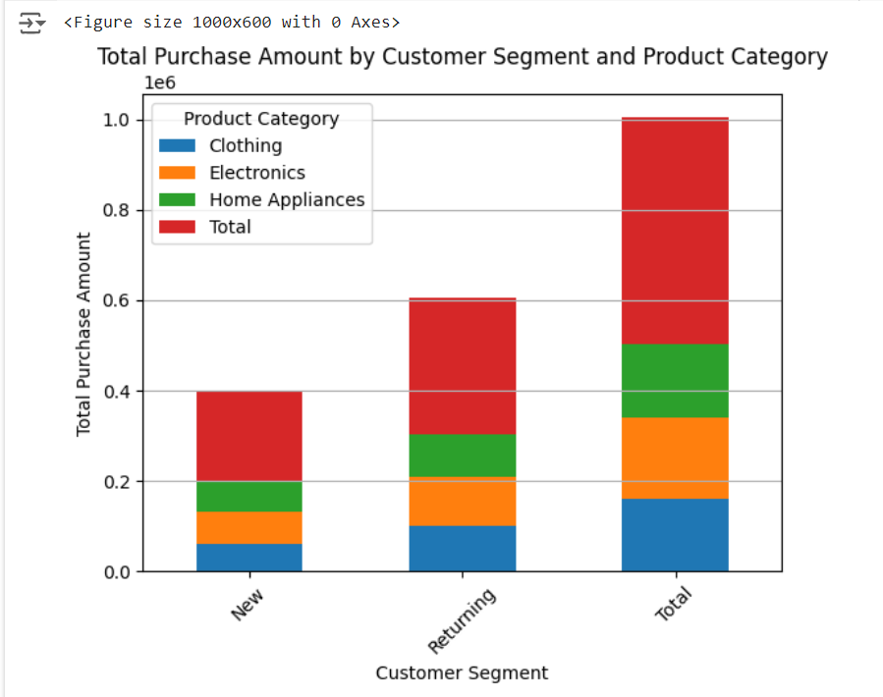
Results(Screenshot)

Slide 63
Problem statement-20 Calculate the average purchase amount per customer for each region. Create a new column and visualize the top 5 records.
DESCRIPTION
Calculate the total purchase amount for each customer segment and product category.
Create a pivot table to summarize the total purchase amounts.
Visualize the results using appropriate charts or graphs to compare purchase amounts across different segments and categories

Slide 64
Code
#problem statement 20
import pandas as pd
import matplotlib.pyplot as plt
# Step 1: Load the sales data from the CSV file
sales_data = pd.read_csv('sales Data.csv')
# Step 2: Group the data by 'Region' and 'CustomerID' and calculate the total purchase amount per customer
total_purchase_per_customer = sales_data.groupby(['Region', 'CustomerID'])['PurchaseAmount'].sum().reset_index()
# Step 3: Calculate the average purchase amount per customer for each region
average_purchase_per_customer = total_purchase_per_customer.groupby('Region')['PurchaseAmount'].mean().reset_index()
# Step 4: Create a new column to store the average purchase amount per customer
average_purchase_per_customer.rename(columns={'PurchaseAmount': 'AvgPurchasePerCustomer'}, inplace=True)

Slide 65
# Step 5: Visualize the top 5 records
top_5_records = average_purchase_per_customer.nlargest(5, 'AvgPurchasePerCustomer')
print(top_5_records)
# Optionally, you can visualize the top 5 records using a bar plot
plt.figure(figsize=(10, 6))
plt.bar(top_5_records['Region'], top_5_records['AvgPurchasePerCustomer'], color='skyblue')
plt.title('Top 5 Regions by Average Purchase Amount per Customer')
plt.xlabel('Region')
plt.ylabel('Average Purchase Amount per Customer')
plt.xticks(rotation=45)
plt.grid(axis='y')
plt.show()

Slide 66
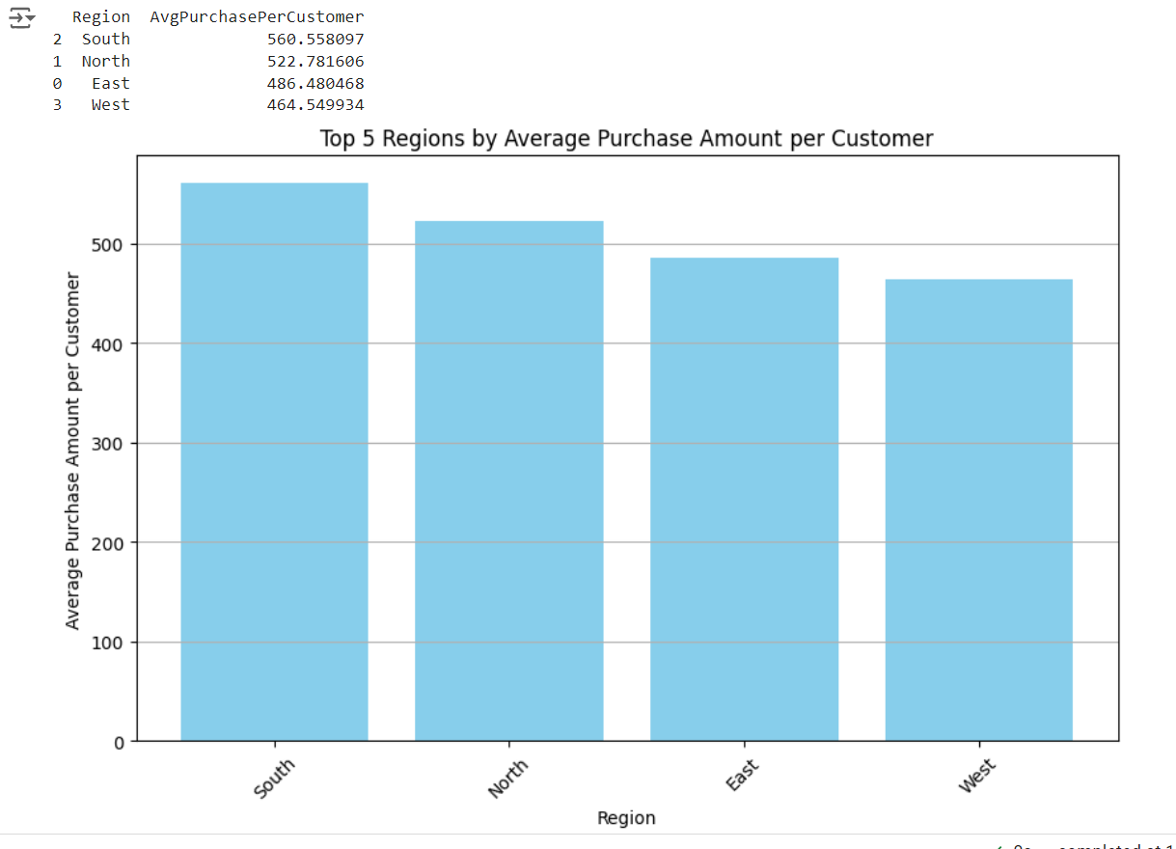
Results(Screenshot)

Slide 67
Conclusion
The distribution of purchase amounts varies across different product categories.
Ratings vary across different customer segments.
The heatmap and scatter plot reveal insights into the correlation between age and purchase amount
Analysis shows the number of unique customers in each region and overall.
Pie chart visualization illustrates the distribution of total purchase amounts across payment methods
A well-designed data ingestion pipeline ensures efficient and scalable data acquisition from various sources
Implementation of the ingestion pipeline facilitates the transfer of data from source to database for further processing

Slide 68
Optimization of the ingestion pipeline enhances performance and reduces resource utilization for efficient data processing
Analysis provides insights into the average shipping durations for different locations
Visualization aids in identifying categories with higher return rates
Statistical analysis determines if there is a significant difference in purchase amounts between male and female customers
Visualization aids in comparing purchase amounts between weekends and weekdays
The designed data warehouse schema provides a blueprint for organizing and storing data efficiently, ensuring easy retrieval and analysis.

Slide 69
References
https://github.com/sandhiputi-satya/futurense-intership/blob/main/GROUP-F%20PROJECT%20CODES.ipynb
https://github.com/sandhiputi-satya/futurense-intership/blob/main/sales%20Data.csv

Slide 70
Thank you!!!

